Slide 1


Happiness Is Homemade ‘Recipe finder webapplication’ {
BATCH_B4.html
LJ_UNIVERSITY.css
[Search and cook delicious delicacies…..]
< ul class=“coders_at_the_back”>
<li>Meghwin Dave – 22002171220009</li>
<li>Sanket Shah – 22002171220052</li>
<li>Nandan Jogi – 22002171220018</li>
<li>Richa Modi – 22002171220083</li>
<li>Tehsin Vora – 22002171220102</li>
</ul>
}
Django Project

Slide 2
Table Of ‘Contents’ {
01
02
03
BATCH_B4.html
LJ_UNIVERSITY.css
Introduction
< Brief of what our
project is>
Techologies and Modules Used
< Python, django, bootstrap, fontawesome, google fonts, etc>
Mockups
< What our application looks like >
}
Django Project

Slide 3
Introduction; {
BATCH_B4.html
LJ_UNIVERSITY.css
01
‘Here we present you our RECIPE FINDER WEB APPLICATION ’
<p>
Every thing you need to cure your hunger at your fingertips.
Here you can search recipe or you can get recipes recommended by us and you can even get recipes by our trusted users.
</p>
}
Django Project

Slide 4
Technologies {
BATCH_B4.html
LJ_UNIVERSITY.css
02
40%
Django
40%
Html,Css,Bootstrap
< Front end designing >
< Backend database, Site integration and api calls>
Other Tools
20%
< For Frontend designing >
}
Django Project

Slide 5
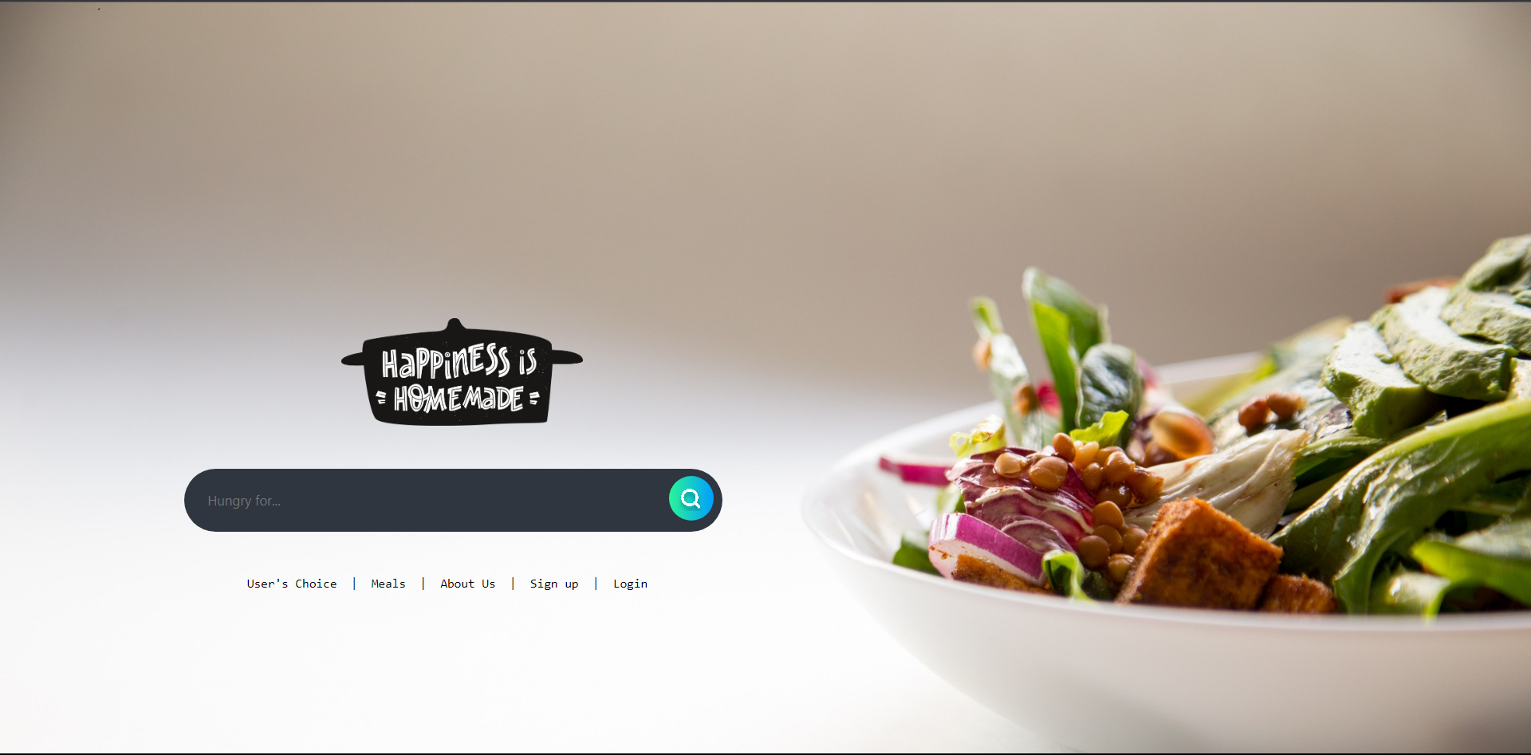
Mockups {
BATCH_B4.html
LJ_UNIVERSITY.css
03
This is how our webapplication looks like
}
Django Project

Slide 6
BATCH_B4.html
LJ_UNIVERSITY.css
Thanks; {
‘Do you have any questions?’
meghwindave@gmail.com
LJ UNIVERSITY
}
Django Project

